Slide 1
DSA Project
Project Title: News Trust Model
Course Details:
CSL2020, Data Structures and Algorithms
Professor: Dr. Suchetana Chakraborty
Mentor TA: Anshul Jain (M24CSA002)
Team Members:
Shreyansh Agarwal (B23PH1024)
Malav Parekh (B23ME1029)
Kumar Harsh (B23BB1025)
Ishan Rajpurohit (B23CH1019)
Github Repo: https://github.com/Shreyansh9878/Fake-New-Detection.git

Slide 2
🧩Problem Statement
🔍 The Problem
Online news is abundant but not always trustworthy.
It's hard for readers to judge the credibility of what they read.
News articles often lack transparent citation networks, unlike academic papers.
🌐 Domain & Use Case
Domain: Digital journalism, media analytics, and misinformation detection.
Use Case: A tool that builds networks of news articles and assigns trust scores using citation and similarity links.

Slide 3
🧩Problem Statement
⚠️ Why It’s Important
Misinformation and fake news are rising and can influence:
Public opinion
Elections
Health behavior (e.g., during pandemics) and many more.
Promoting media literacy and source transparency is vital.
🔧 Why It’s Challenging
News rarely follows a consistent citation format.
Many articles cite nothing or only link internally.
Trust is subjective and hard to quantify.
Web scraping and similarity detection are technically complex.

Slide 4
🧩Problem Statement
📊 Why Data-Driven Works
Trust can emerge from patterns in citation behavior.
Using a graph model and PageRank Algorithm, we can:
Measure source centrality and influence.
Detect echo chambers and unverified sources.
Allow for automated, scalable trust estimation.

Slide 5
📍Current Status
Trust Model Components:
Expertise: Topic relevance & writing quality
Goodwill: User feedback & engagement
Coherence: Consistency of source over time
Output: Dynamic trust scores via weighted aggregation
ML Techniques Used:
It was used with an ML model.
XGBoost: For message-based classification
BERT/ALBERT: For fact-checking via semantic similarity
Key Limitations:
Static weight tuning (no real-time adaptation)
No graph-based trust propagation
Relies on labelled datasets; struggles with unseen content
https://ieeexplore.ieee.org/document/10262169

Slide 6
💡 Proposed Idea
Our solution aims to evaluate the trustworthiness of news articles by leveraging the credibility of their sources and interconnections between them. The core components of our approach are:
Source-Based Scoring: Each article's initial trust score is derived from the historical trustworthiness of the news site that published it.
Cross-Verification: The trust score is adjusted based on other news sources that have published similar news, either corroborating or contradicting the original article. But we don’t really consider if it is corroborating or contradiction.
Citation and Propagation Network: We model a network of news sources using explicit citations (if present) or similarity-based linking. Trust scores propagate through this network, allowing us to refine article credibility via a process similar to PageRank.
Github Repo: https://github.com/Shreyansh9878/Fake-New-Detection.git

Slide 7
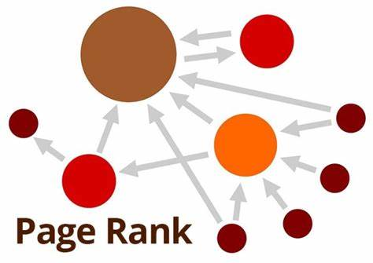
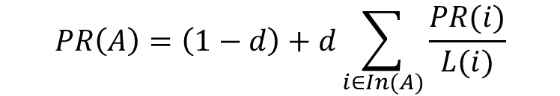
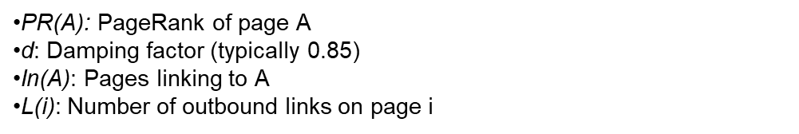
💡 Proposed Idea
📊 PageRank Algorithm
What is it?
A link analysis algorithm developed by Google founders.
Measures the importance of a webpage based on incoming links.
Core Idea:
A page is important if it is cited by other important pages.
Applications:
Web search ranking
Trust propagation in networks
Social influence analysis

Slide 8
💡 Proposed Idea
🧭 Workflow Steps – News Trust Evaluation Pipeline
User Input:
The user provides the URL of a news article they wish to evaluate.
Graph Node Creation:
The algorithm converts the given article into a node in the graph. Metadata such as the headline, main content, and any external citations (links to other news sources) are extracted.
Content Preprocessing:
The article content undergoes stopword removal, resulting in a set of significant terms.
These terms are then inserted into a Trie data structure for efficient matching and comparison.
Citation Handling:
If external citations exist: Each cited article is fetched, parsed, and added as a new node. The headline, content, and its citations are similarly extracted.
If no citations exist: The system performs a semantic similarity search to find articles on other news sites reporting similar events. These are also added as connected nodes.

Slide 9
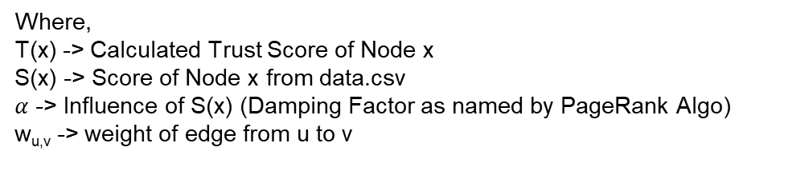

💡 Proposed Idea
Edge Creation & Weight Assignment:
For each connected article, the stopword-removed content is compared to the main article’s Trie structure to determine content similarity.
This similarity score is used as the weight of the edge between the nodes, representing the strength of trust propagation.
Trust Propagation:
After the graph is constructed, PageRank is run on the citation/similarity network to compute trust scores for each article, influenced by both source reputation and content agreement.
$$T\left(u\right)= α S\left(u\right)+(1−α)\frac{\sum_{v ε adj_list(u)}{w_{u,v}T(v)}}{\sum_{v ε adj_list(u)}{w_{u,v}}}$$
Where,
T(x) -> Calculated Trust Score of Node x
S(x) -> Score of Node x from data.csv
$α$ -> Influence of S(x) (Damping Factor as named by PageRank Algo)
w_{u,v} -> weight of edge from u to v

Slide 10
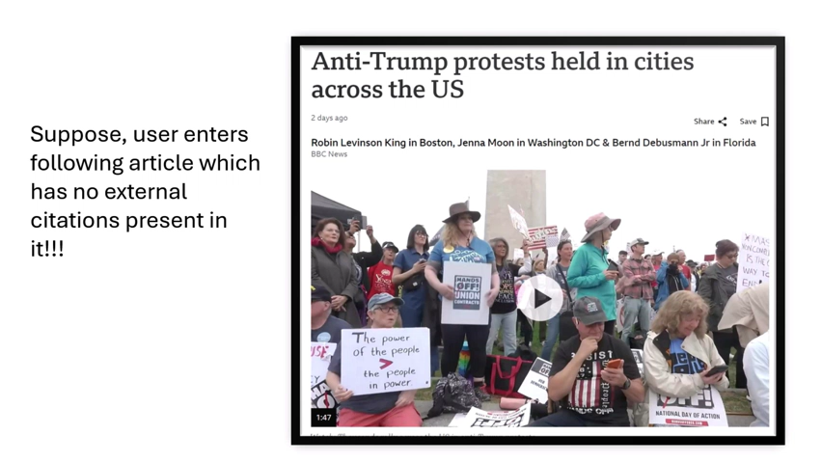
💡 Explanation of Solution [Play Video]

Slide 11
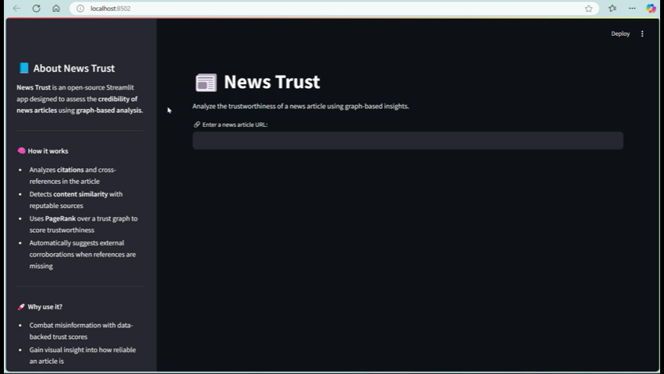
💡 Example Walkthrough of Solution [Play Video]

Slide 12
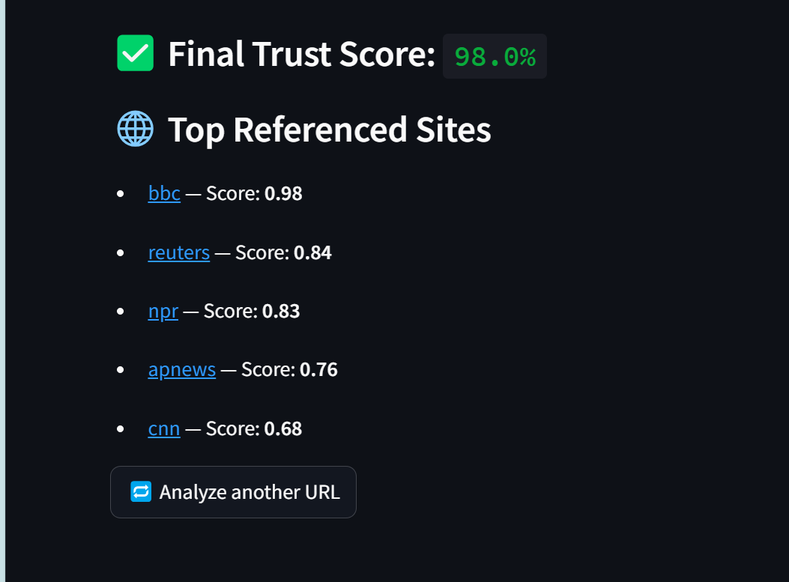
✅ Highlights & Results
Successfully created a graph-based trust evaluation system.
Can process a news URL and find trust-related links, even without citations.
Demonstrated ability to:
Detect similar news coverage across sources.
Assign and propagate trust scores using PageRank.
Visualize trust connections and weak links.
Helps identify potential misinformation or isolated/unverified reporting.

Slide 13
⚠️ Drawbacks of Current Model
Reliance on Site Reputation Dataset:
Initial trust score depends on a predefined list (e.g., data.csv). The dataset is custom created by us and may not be that accurate.
No Semantic Understanding (Yet):
Keyword-based similarity (e.g., Trie) doesn’t fully capture meaning. Paraphrased content might be missed.
Sentiment of the contents are not captured.
Scalability Concerns:
Real-time scraping and graph expansion may become resource-intensive as the number of articles grows.
Citation Absence Challenges:
In cases where no citations exist, similarity search might not always find relevant articles, leading to gaps in trust estimation.
Dynamic Content & Paywalls:
Some news sites have dynamic or restricted content or restricted web scraping measures, making automated scraping unreliable or difficult.

Slide 14
🚀 Future Improvements
Use Semantic Embeddings (BERT, SBERT) and Sentiment Analysis:
Enhance similarity detection between articles using sentence-level embeddings for better semantic matching and use sentiment analysis to assign negative weights for anti contents.
Dynamic Trust Learning:
Incorporate user feedback, article corrections, or fact-check scores to adjust trust scores over time.
Real-Time Trust Feed / Browser Plugin:
Build a lightweight plugin or dashboard to provide live trust scores for articles users are reading.
Scalable Backend:
Implement asynchronous scraping and graph databases (e.g., Neo4j) for handling large-scale news networks efficiently.
Multilingual Support:
Extend trust modeling to non-English news articles using multilingual NLP tools.
Machine Learning Model:
Use the model with a machine learning fake news detection model for better scoring.

Slide 15
💸 Cost Analysis
Component | Resource Use
Web Scraping | Non-scalable, Requires moderate- hight bandwidth
Text Processing (Trie) | Low memory, Quick lookup for words
Graph | O(N+E) Time and Space, Medium-Extensive CPU usage (as things scale)
PageRank Computation | O(N+E) Time Complexity (Same as dfs)

Slide 16
⚖️ Cost-Benefit Trade-Off
Cost | Benefit
More Computation for NLP similarity | Detects trustworthiness even without explicit citations
Graph storage/memory with large-scale scraping | Enables global view of trust networks and helps look at much larger picture
PageRank iterations (depends on graph size) | Produces refined, non-binary trust scores

Slide 17
📝Acknowledgement
https://ieeexplore.ieee.org/document/10262169
👥Contributions
Shreyansh Agarwal (B23PH1024): Implementation of PageRank Algorithm, Dataset Creation, Graph Visualization over Streamlit
Ishan Rajpurohit: Graph Creation, Streamlit
Malav Parekh: Web Scrapping
Kumar Harsh: Content Comparison, Creation of Trie, Filler Word Removal

